Slide 1
Greenhouse Rover Stable Sensor Mast
Group 10:
Bryce Dudley, Alex Maytas, Keenan Rowcliffe, & Kathryn Wemple

Slide 2
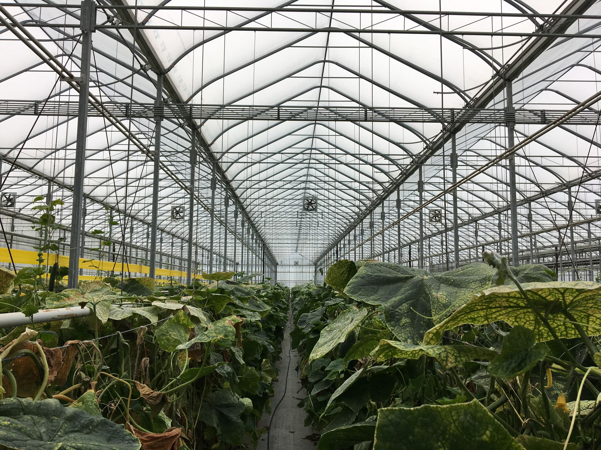
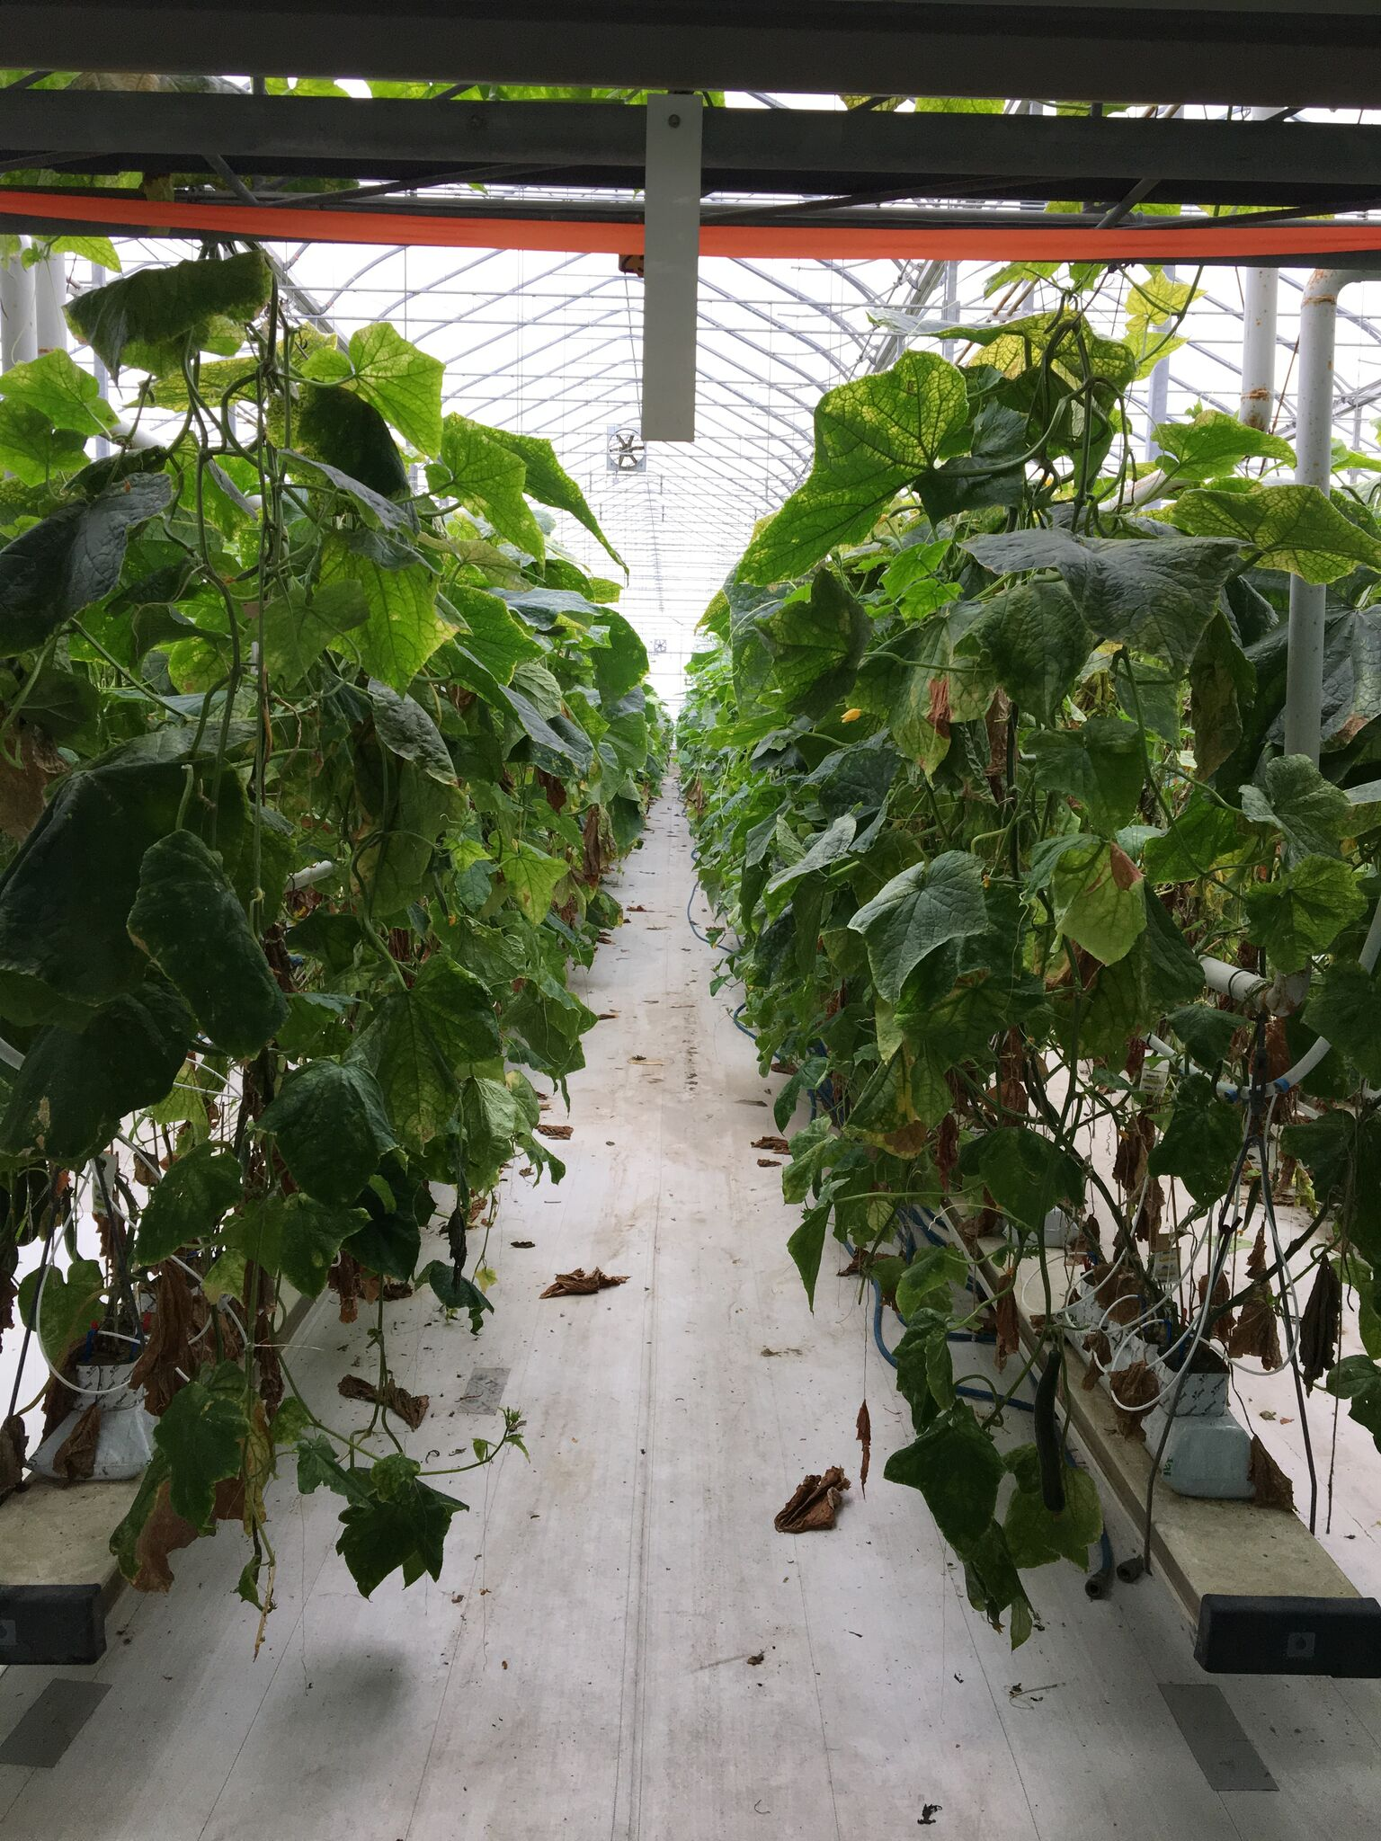
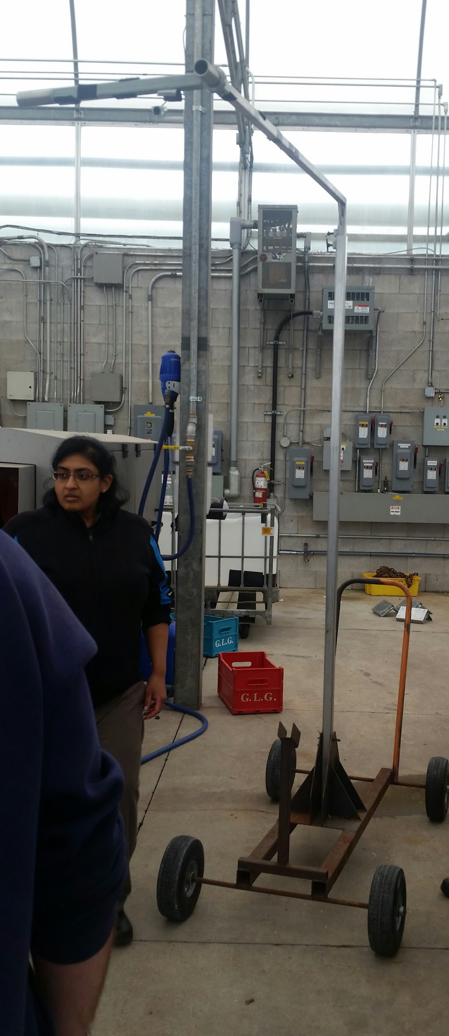
Problem Statement & Constraints

Slide 3
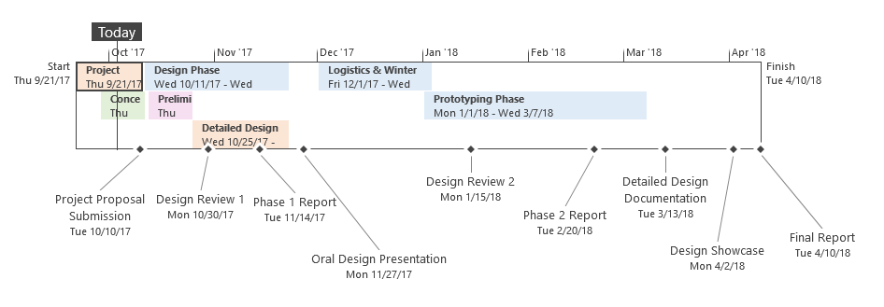
Project Plan - Task Timeline

Slide 4
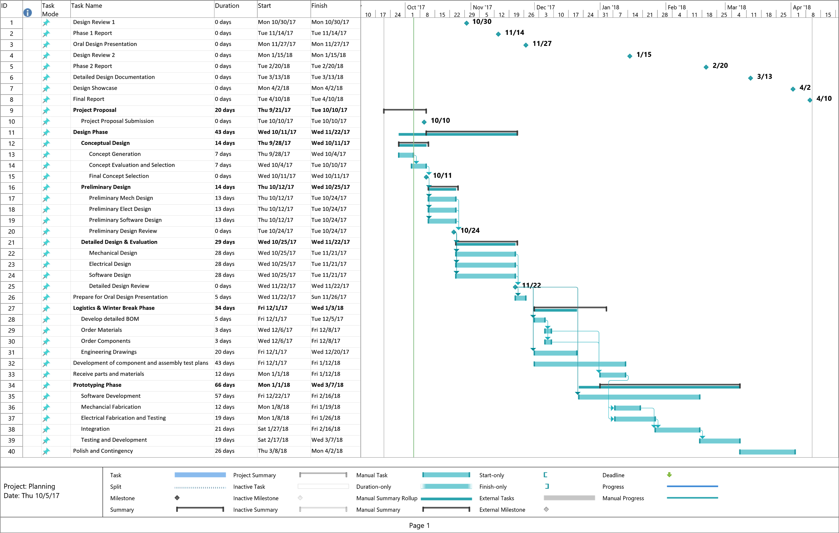
Project Plan - Gantt Chart

Slide 5
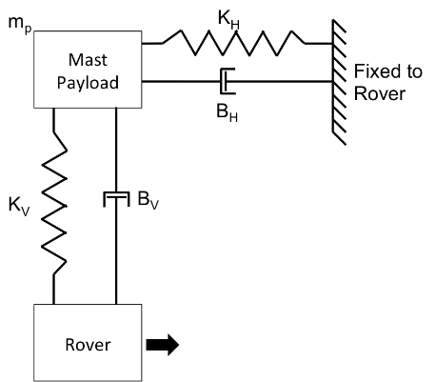
Mathematical Model

Slide 6
Concept Generation

Slide 7
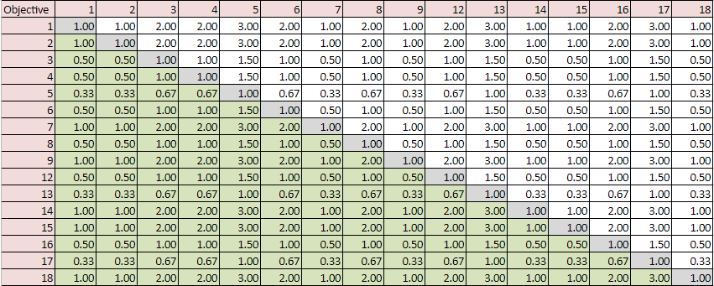
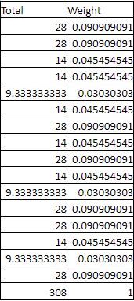
Concept Selection - Objectives Weighting

Slide 8
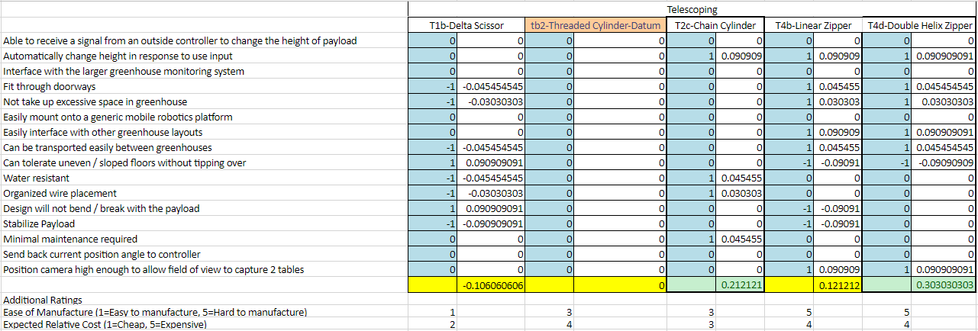
Decision Matrix - Mast Component

Slide 9
Preliminary Design

Slide 10
Next Steps

